Slide 1
Overview of Groups Successes
Zorana Maravic
Director Group Development

Slide 2
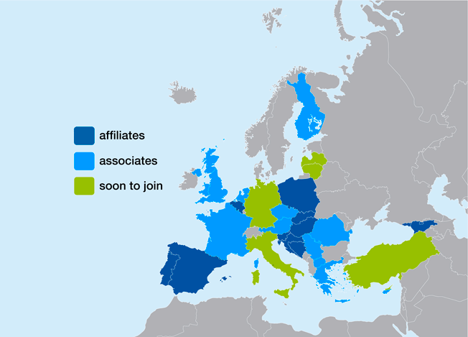
EuropaColon – Current groups
Belgium
Bosnia
Hungary
Latvia
Poland
Portugal
Serbia
Slovakia
Slovenia
Spain
Austria
Cyprus
Czech Republic
Finland
Germany
Greece
Hungary
Netherlands
Macedonia
Romania
UK

Slide 3
Group Activities
Other patients’ org.
General public
Patients and family members/
carers
PASYKAF, Colores, Recovering Together Association, Darmkanker Netherland, EuropaColon Latvia, Borka, Serbian Association of CRC Patients, EuropaColon Slovakia, EuropaColon Slovenia, EuropaColon Portugal, EuropaColon Spain, Bowel
Cancer UK
Media
Sponsors/
Pharma-ceutical industry
Government
Physicians/ Nurses/ Hospitals

Slide 4
Cyprus
Patient support – home care service, psychological support, transportation and other
Partner of the MoH in the screening process (Feb 2013)
Lectures for general public (healthy living, importance of screening
“Golf 4 Hope – I love my Healthy and Active Childhood” campaign
“Life with Cancer… Change for a better Me” event
Presentations in kindergartens and primary schools

Slide 5

Finland
Cooperation with Cancer Society of Finland and other organisations
Lectures for general public - medicine, nutrition, social psychology
Support for patients and carers
Collaboration with pharmaceutical industry – Colorectal Summit once per year
Collaboration with University and Privat cancer centers
Good media presence

Slide 6

Hungary
“Your colonoscopy experience”
Press conference with Dr. Kálmán Nagy member of the Hungarian Parliament
Research on the CRC awareness of university students
“How media and advertisement techniques work - cancer patients are in target”
Great media coverage of all the activities
Although one of the youngest group – 272 active members

Slide 7
Latvia
Raising CRC awareness among general public
Recruitment of new members
Advocacy and lobbying activities
First pan-Baltic meeting dedicated to CRC in Riga, Latvia on the 15th of May, 2013
  Patients, physicians, government representatives and media from Estonia, Lithuania and Latvia

Slide 8

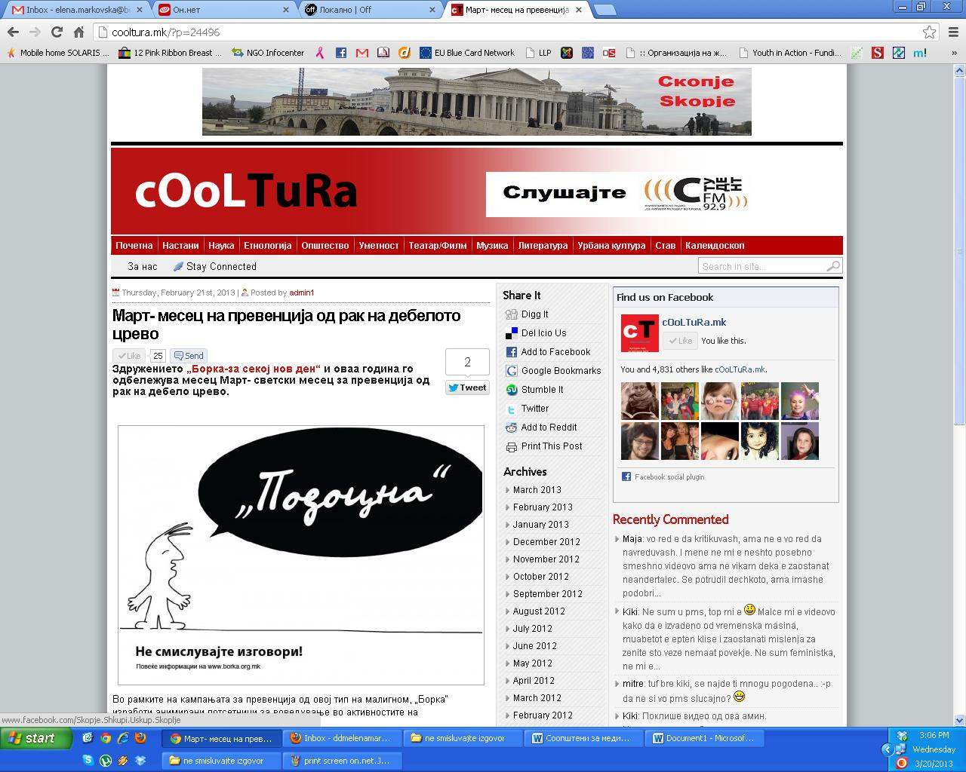
Macedonia
“Don’t make excuses” - campaign together with the MoH and Institute for Public Health – free FOBT for high risk citizens
Informative leaflet for general public
Press conference
Media presence (electronic media)
Support for CRC patients (booklet, visits to the hospital, telephone helpline)
Inflatable colon

Slide 9

Netherlands
Symposium on CRC for patients and partners
Symposium for general public
Psycho-social care
Active involvement in the screening process
Revision of CRC guidelines
Scientific medical studies
Media presence

Slide 10


Poland
National Colorectal Surgery Symposium – "emotions during neoplastic disease prevention and health related aspects" and "the element of education for families of patients”
"Changing the statistics using the Prevention”
Conference “Controversies in Oncology”
“Excuse you” campaign

Slide 11

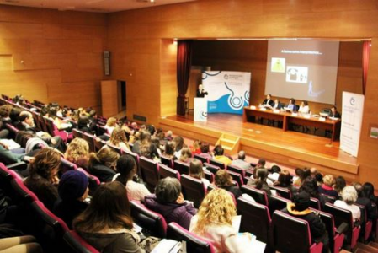
Portugal
Lecture “Cancer: The Role of Medicine, Nursing, Nutrition and Psychology in Patient Care”
Media presence (Press, Internet, TV, Radio, etc.)
Support Group Session for patients and survivors “5 Themes, 5 Nights”

Slide 12

Serbia
“Don’t make excuses” – campaign supported by the MoH with the aim to raise the awareness of the importance of screening
  300000 leaflets delivered to all households in the Belgrade area
  big street events with inflatable colon at Belgrade and Nis – 10000 leaflets handed out, together with FOBT
“Join us” patient support programme

Slide 13


Slovakia
„Test your own risk of colorectal cancer“ supported by the Clinical Lead of proposed national screening programme and Patrik Herman (award winning TV celebrity). The campaign focuses on educating citizens to understand and act on identifying genetic prediposition to CRC.

Slide 14

Slovenia
Press conference
Lecture for physicians in Nova Gorica
Koloskop

Slide 15

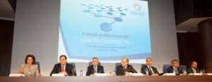
Spain
Awareness campaign in Madrid – leaflet distribution in El Corte Ingles centers
Meeting with Colon Cancer Allience – “Mass screening for CRC: cost-effectiveness, treatment process and social process”
Media activities

Slide 16

UK
BCAM activities - health promotion talks, events and information stands, Great Start Breakfast fundraising events, social media and press coverage
Two pilot General Practitioner (GP) Bowel Disease study days for 200 delegates
Together with Breast Cancer Care - 8 two-day breast and bowel cancer awareness courses to over 100 health care and community professionals
Resource and training programme to enable people with learning disabilities and their care providers to engage with the bowel screening programme in Scotland and to understand the importance of good bowel health.
Campaign to improve services for young bowel cancer patients

Slide 17
Active participation in the preparation and promotion of CCPC
Promoting CCPC through newsletter distribution, media release distribution and by posting web-banner on the website
Case studies: Finland, Germany, Hungary, Latvia, UK
Posters: Germany, Macedonia, Portugal, Romania, Serbia, Slovakia and Spain
Speakers: Milan Djordjevic (Serbia), Adriana Melnic (Romania), Barbara Moss (UK), Vitor Neves (Portugal), and Wolfram Nolte (Germany)

Slide 18
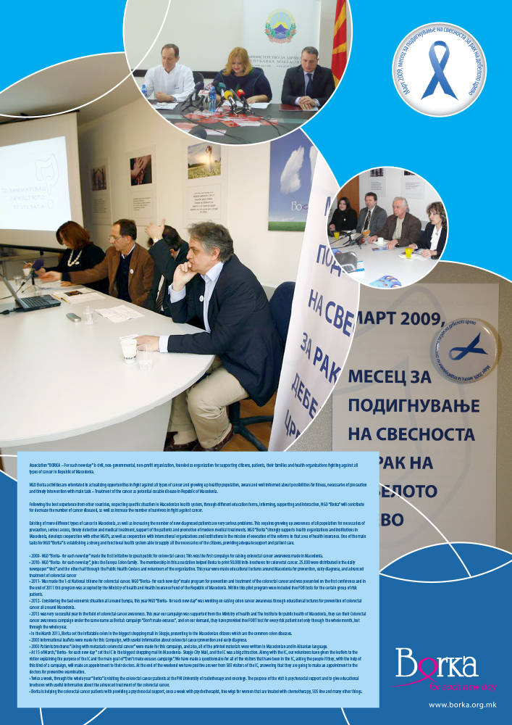
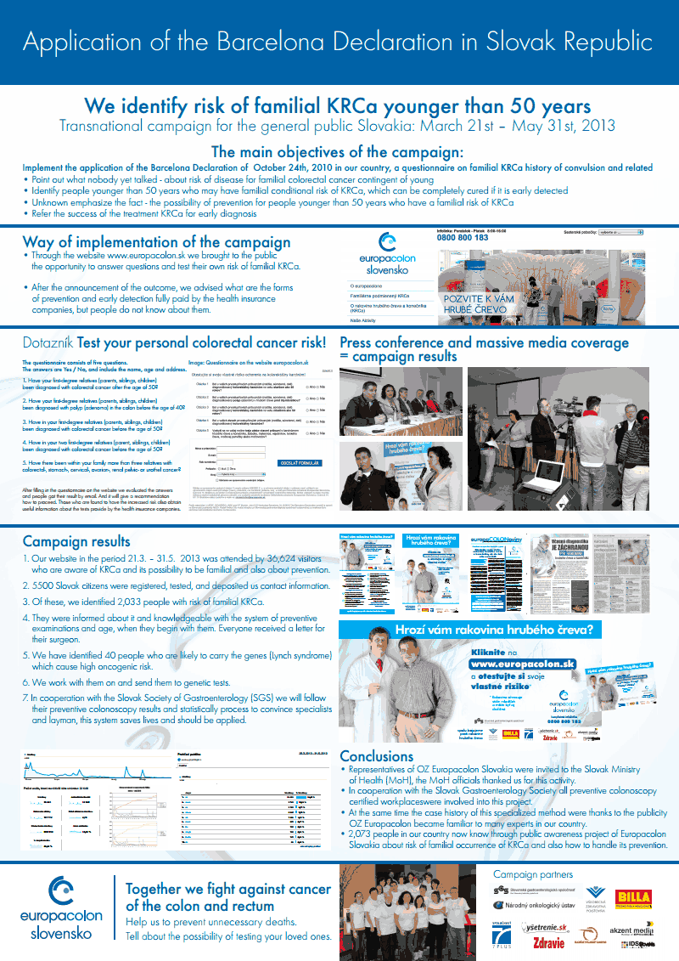
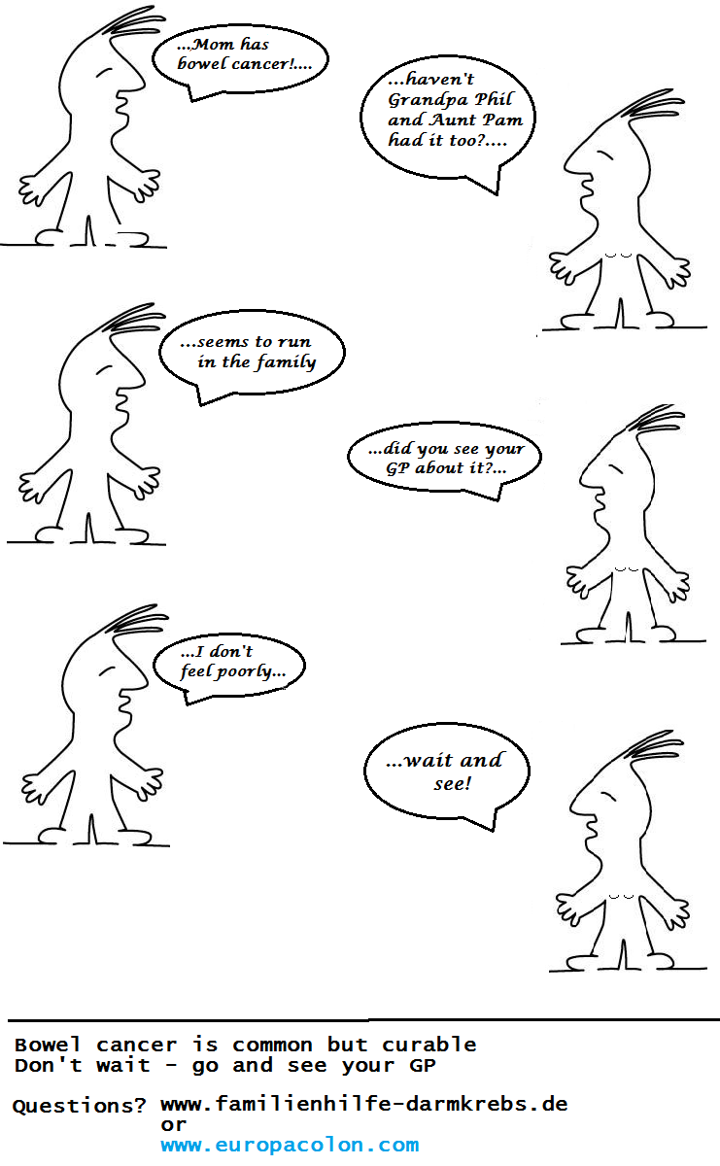
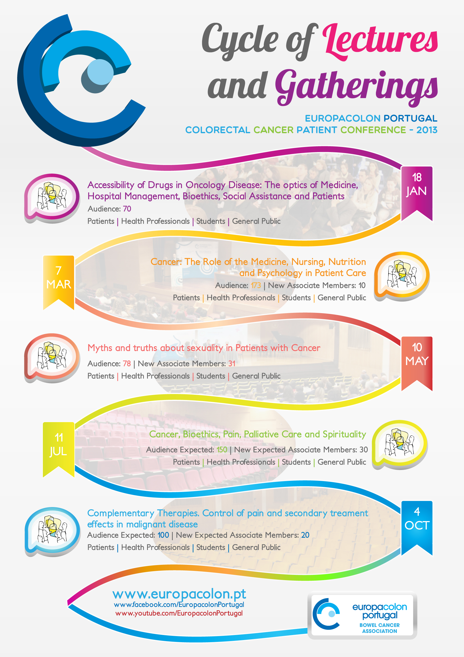
Posters for competition
Germany
Portugal
Macedonia
Slovakia

Slide 19
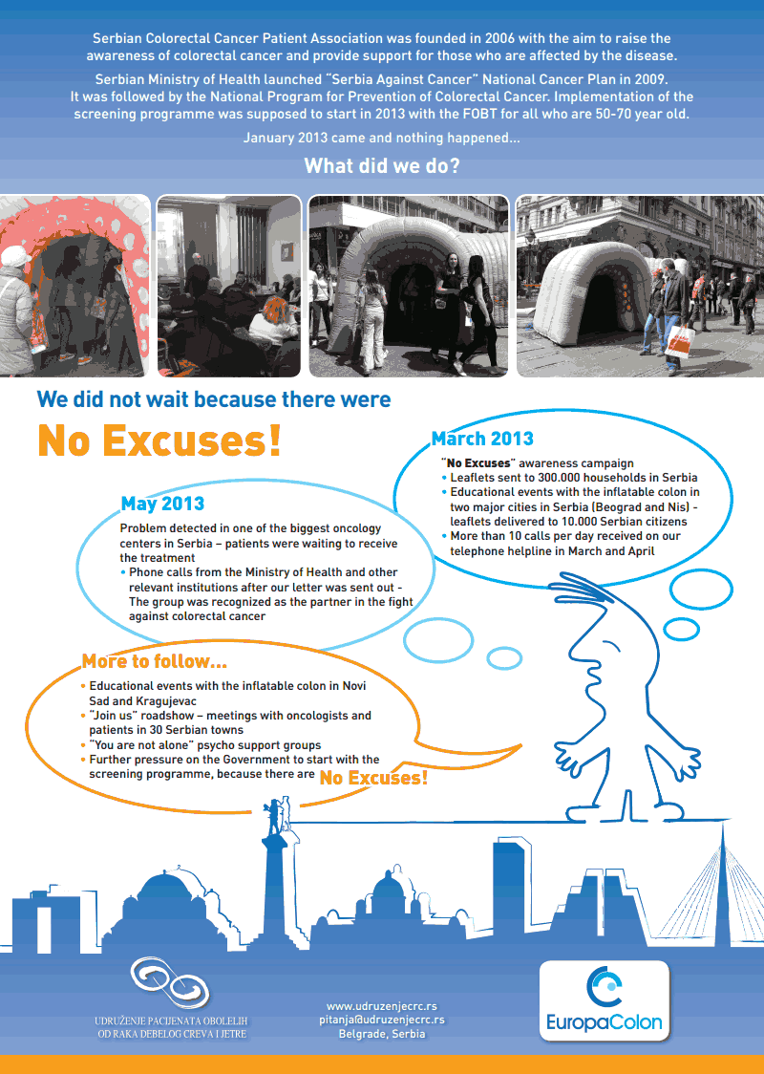
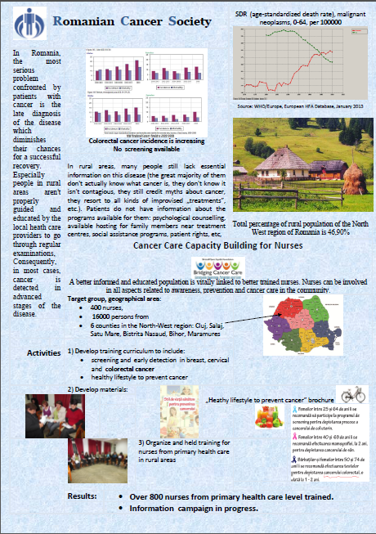

Posters for competition – cont.
Romania
Spain
Serbia

Slide 20
Groups to join
Bulgaria
Denmark
Estonia (Estonian Cancer Society)
France (Association France Côlon)
Georgia
Germany (EC Germany)
Italy
Lithuania (Lithuanian Cancer Patient Coalition)
Malta (National Screening Center)
Norway
Romania (Romanian Federation of Cancer Patients)
Russia (Equal Right to Life)
Sweeden
Turkey (Genc Birkim Dernegi)
Ukraine

Slide 21
THANK YOU!
zorana@europacolon.com

